Slide 1
Introductory General Chemistry
Chemistry 3A
Experiment 10a
Types of Reactions
Mitch Halloran

Slide 2
Introduction
There are countless chemical reactions that can occur
But reactions fall within certain types, certain categories
This experiment is about studying one of each reaction that falls within a certain type or category

Slide 3
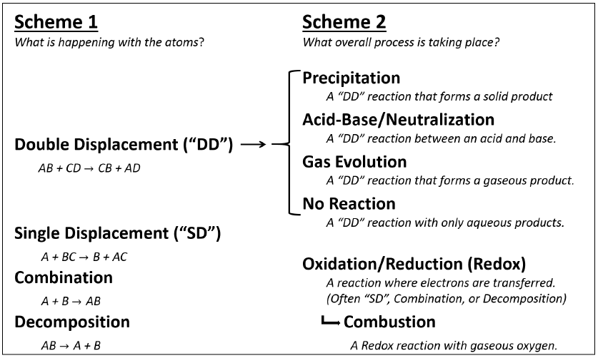
Background
With the types/categories of reactions, two “schemes” emerge
Scheme 1 is “what happens with atoms?” Scheme 2 is about process

Slide 4
Background
With the types/categories of reactions, two “schemes” emerge
Scheme 1 is “what happens with atoms?”
Double displacement (DD), single displacement (SD), combination, decomposition
Scheme 2 is about process: precipitation (DD), neutralization (DD), gas evolution (DD), dissolution only; redox, combustion
Precipitation
Salt (aq) + Salt (aq) | → | New Salt (s) + New Salt (aq)
2 NaCl (aq) + Pb(NO₃)₂ (aq) | → | PbCl₂ (aq) + 2 NaNO₃ (aq)
Acid-Base / Neutralization
Acid (aq) + Base (aq) | → | Salt (aq) + Water (l)
HNO₃ (aq) + KOH (aq) | → | KNO₃ (aq) + H₂O (l)

Slide 5
Background
Gas Evolution
Salt (aq) + Acid (aq) | → | New Acid (s) + New Salt (aq)
New Acid (aq) | → | Gas (g) + Water (l)
Na₂SO₃ (aq) + 2 HCl (aq) | → | H₂SO₃ (aq) + 2 NaCl (aq)
H₂SO₃ (aq) | → | SO₂ (g) + H₂O (l)
No Reaction
The mixing of compounds in aqueous solution can sometimes result in none of the reactions mentioned

Slide 6
Background
Oxidation-Reduction (Redox)
2 Na (s) + 2 H₂O (l) | → | H₂ (g) + 2 NaOH (aq)
2 Al (s) + 3 Cl₂ (g) | → | 2 AlCl₃ (s)
Cu (s) + Pd(NO₃)₂ (aq) | → | Pd (s) + Cu(NO₃)₂ (aq)
Combustion
Hydrocarbon (g,l,s) + Oxygen (g) | → | Carbon Dioxide (g) + Water (g)
C₂H₄ (g) + 3 O₂ (g) | → | 2 CO₂ (g) + 2 H₂O (g)
Metal (s) + Oxygen (g) | → | Metal Oxide (s)
2 K (s) + O₂ (g) | → | K₂O (s)

Slide 7
LAB SAFETY
This laboratory session involves the use of seriously caustic chemicals
Goggles and coat—AND ESPECIALLY GOGGLES—must be worn OVER THE EYES at all times if you are within 15 feet of any test tube with an ongoing reaction or containing a caustic chemical, whether you are managing the tube/reaction or not
If you need to take off your goggles for whatever reason, exit the lab room and safely remove them
You should wash your hands before putting your hands on face as a precaution if exiting lab
Failure to observe safety is a reason for excusing you from the lab and taking a zero for the session

Slide 8
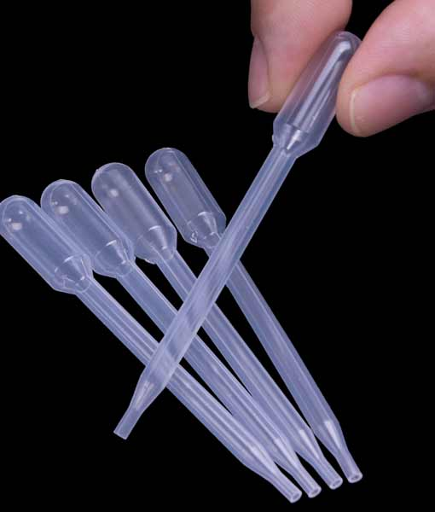
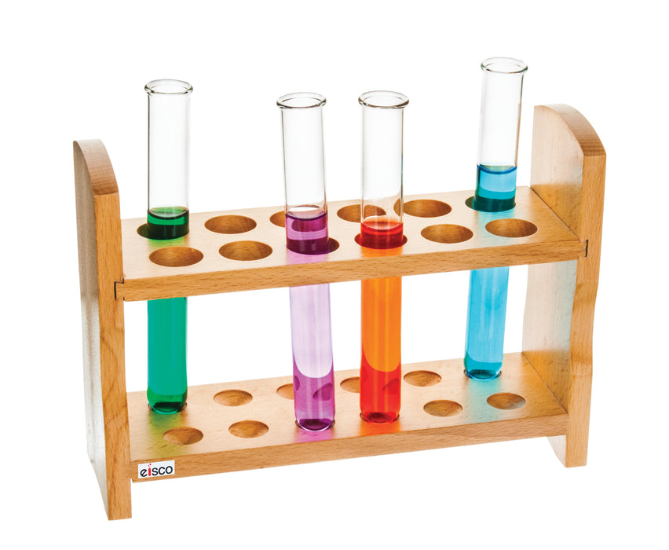
Equipment You Will Use

Slide 9
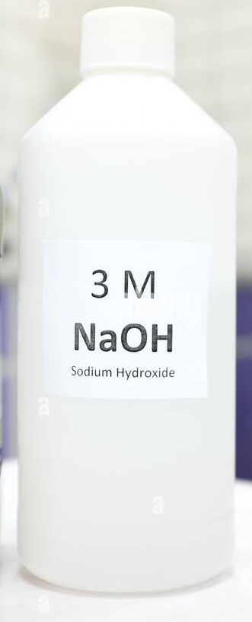
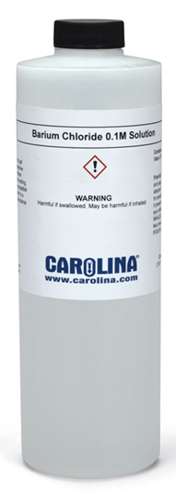
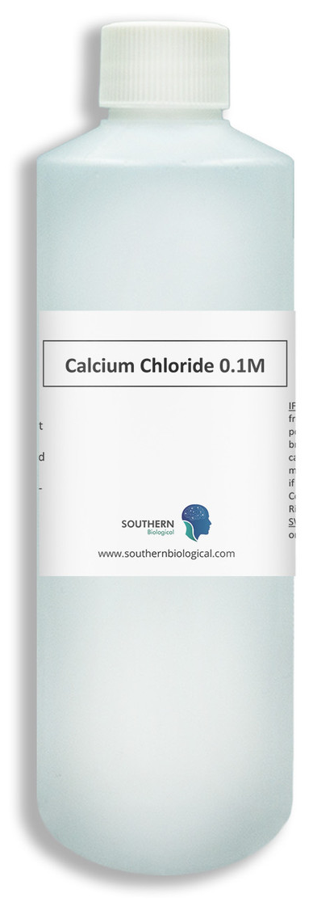
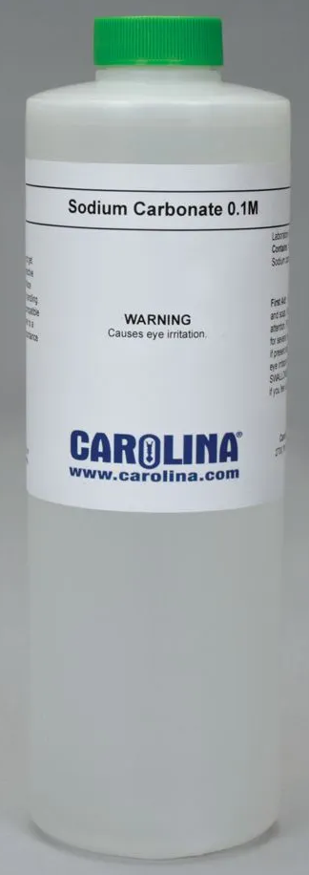

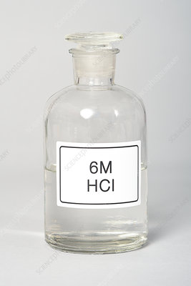
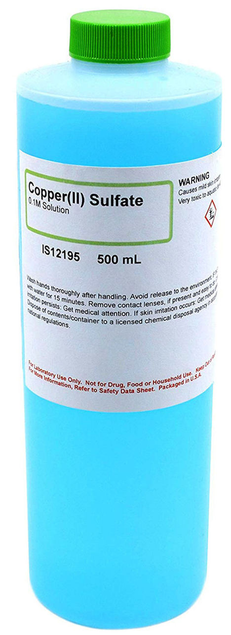
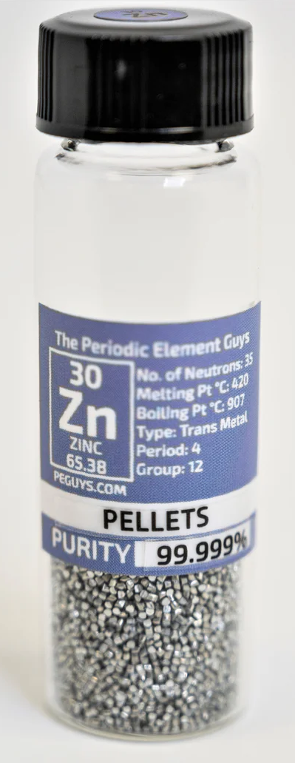
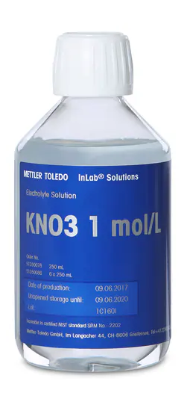
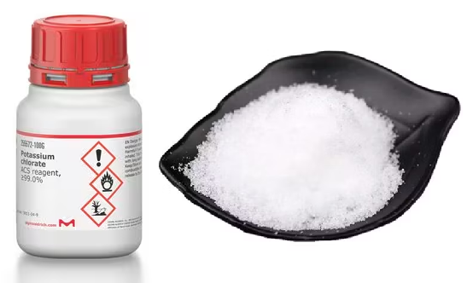
Consumables

Slide 10
Procedure
All reactions will be done in test tubes. Do not concern yourself with measuring out exact quantities
Consider “1 mL reagent” to ~20 gtt (drops) from a transfer pipet or a finger width in height in the test tube
1 g reactant is about a pea size: don’t weigh in balance
Complete the stations in any order
Waste containers are provided: do not dump in sink unless given instructions

Slide 11
Procedure
Station 1
Place ~3 mL 6.0 M HCl in tube
Add a few Zn pellets, record observations
Get another empty test tube, invert it over reaction tube. Hold capture tube at angle still upside down, light a match and bring it to mouth of tube. What happens?
Station 2
Place 1 mL 0.1 M BaCl₂ in tube
Add 1 mL 0.1 M Na₂SO₄ to it, and mix/swirl. Record observation
Wait 3-5 minutes and record observation: what is the insoluble product?
While you are waiting at last step, perhaps go to another station and start that experiment

Slide 12
Procedure
Station 3
Place 1 mL 0.1 M BaCl₂ in tube
Add 1 mL 0.1 M Na₃PO₄ to it, and mix/swirl. Record observation
Wait 3-5 minutes and record observation: what is the insoluble product?
While you are waiting at last step, perhaps go to another station and start that experiment
Station 4
Place 2 mL 1.0 M Na₂CO₃ in tube
Add 1 mL 6 M HCl to it, and mix/swirl. Record observation
If you observe a gas, what is the gas. What is the reaction equation?

Slide 13
Procedure
Station 5
Place ~1 g (small scoop) of KClO₃ in tube.
Grab the tube with a clamp at the TOP of the tube
In the fume hood, hold the tube at an angle and heat ONLY the bottom of the tube with blue cone flame of Bunsen burner. Let the KClO₃ melt, let it bubble, and heat until nothing happens
Did anything come out of tube. Record observations.
Station 6
Mix 1 mL 0.1 M CaCl₂ with 1 mL 0.1 M Na₂CO₃
Record immediate observations. Then record observations after 3-5 minutes. Use the solubility tables to determine what product formed.

Slide 14
Procedure
Station 7
Mix 1 mL 6.0 M HCl with 2 mL 3.0 M NaOH
Record observations. Were there temperature changes (use your hand/fingers carefully to see if the mixture is cold or hot). Use understanding of chemistry to predict product(s)
Station 8
Mix 1 mL 0.1 M KNO₃ with 1 mL 0.1 M BaCl₂
Record immediate observations. Then record observations after 3-5 minutes. Use the solubility tables to determine what product formed.

Slide 15
Procedure
Station 9
Transfer 2 mL of 0.1 M CuSO₄ to tube
Add a few Zn pellets. Record immediate observations and after 3-5 minutes. Check if there are solid products what they look like. What accounts for the blue color?
Station 10
Mix 1 mL 4.0 M NH₄Cl with 1 mL 3.0 M NaOH. If there is a gas, what is it?
Moisten red litmus and hold it over the mouth of the tube: what is the color change and what causes it?
Take 2 fingers and waft the air from tube toward yourself: is there any strong odor? Do NOT put your nose or face over the tube!

Slide 16
Example Data Analysis
No example data is available for this laboratory since this is basically an in-lab exam of your knowledge of chemical reactions and the ability to write and balance chemical equations
So giving you the answers directly does not help the learning process
After the reports are submitted, the answers will be supplied for the report if they are not provided otherwise during the laboratory session

Slide 17
Clean Up
The contents of the test tubes you make are to be dumped into waste beakers provided at each station
Wash the Zn pellets with DI water, remove with forceps. The pellets will probably be collected by instructor in larger beaker, rewashed, prepared for drying and later re-use
Most test tubes will likely be put in aqueous inorganic waste
Solids can be flushed from tubes into waste container with minimal water flushing

Slide 18
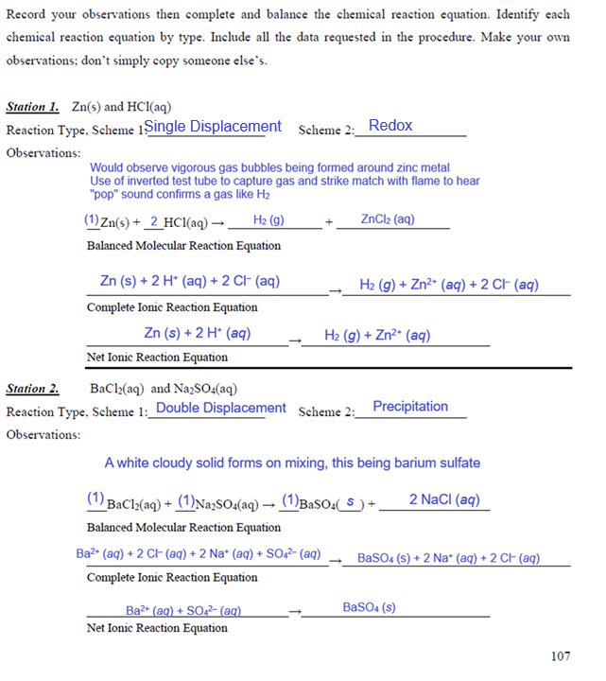

Slide 19
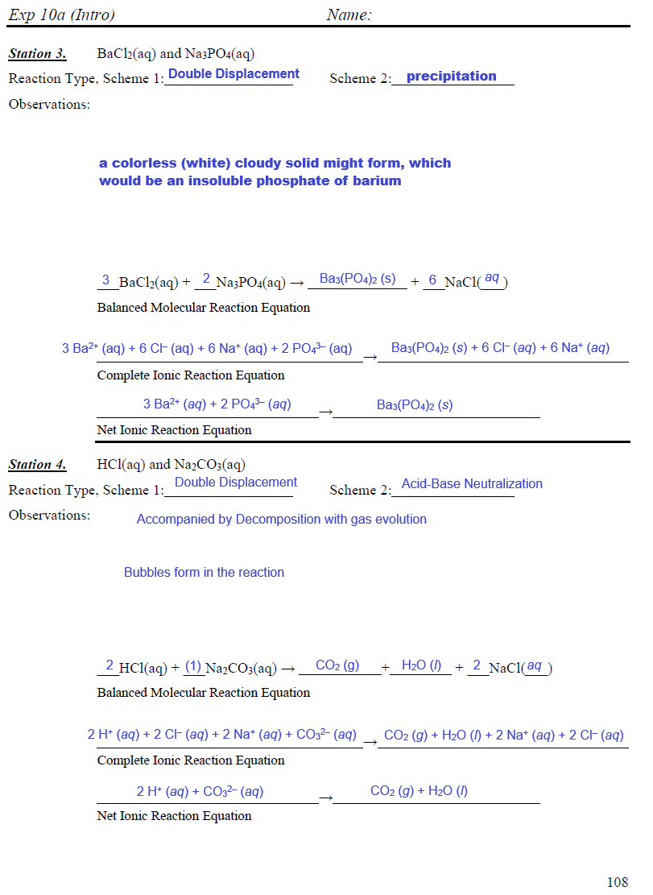

Slide 20
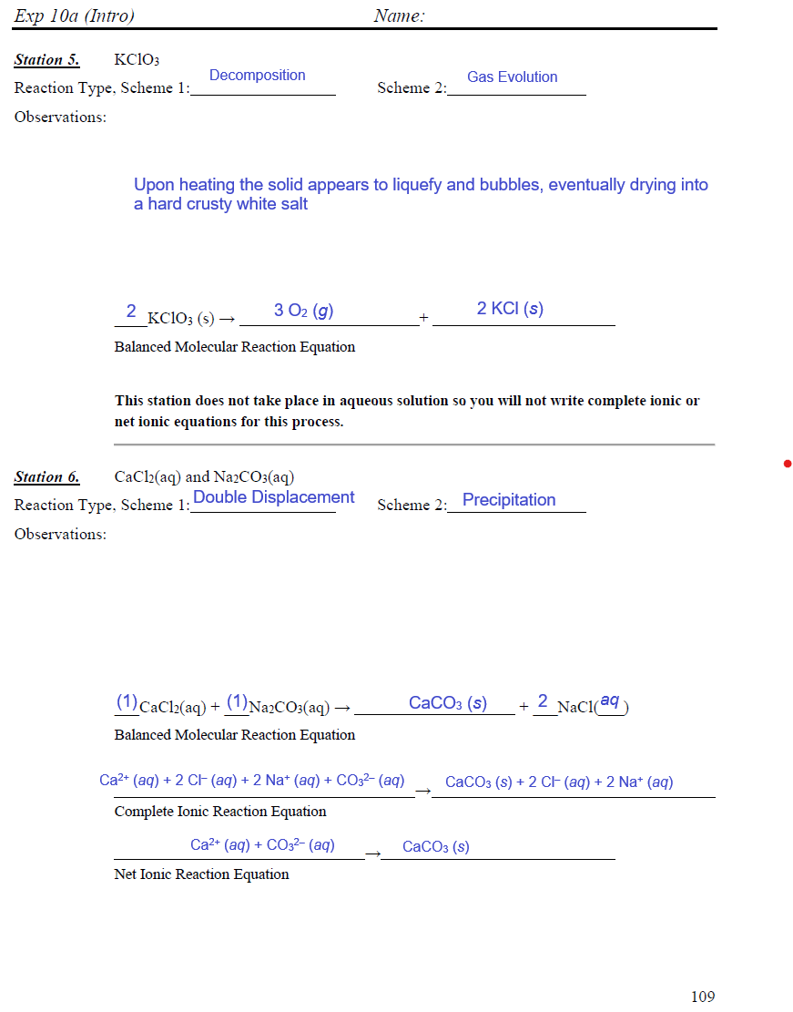

Slide 21
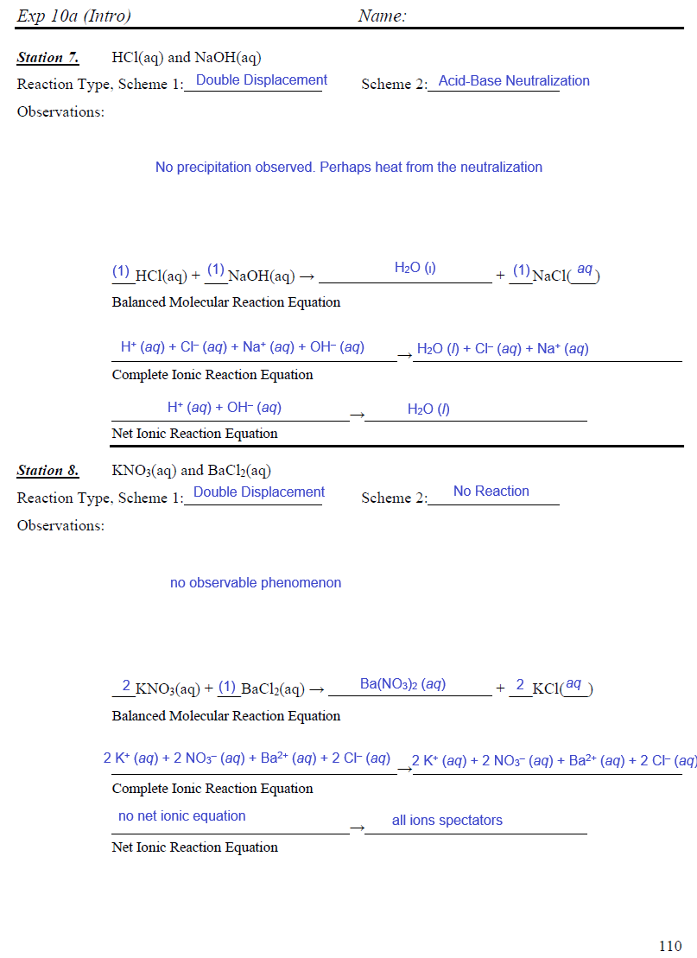

Slide 22
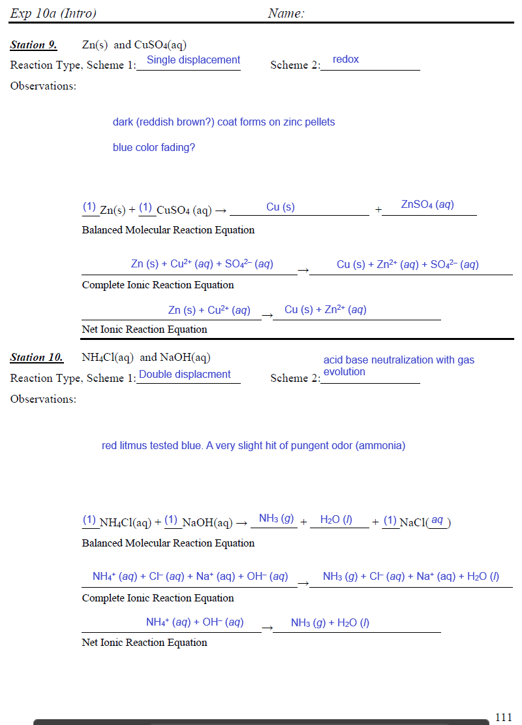

Slide 23
